Slide 1
Heard Island 2016
Robert W. Schmieder
Cordell Expeditions
Explorers Club
18 Nov. 2016

Slide 2
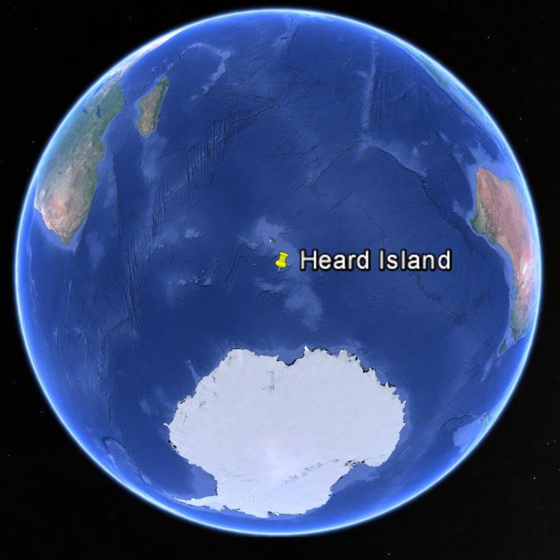

Slide 4
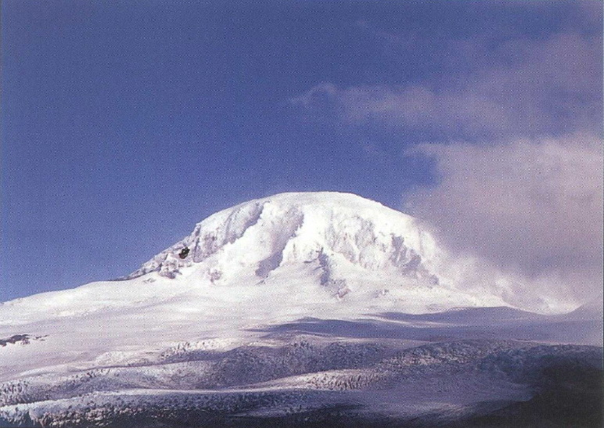

Slide 5
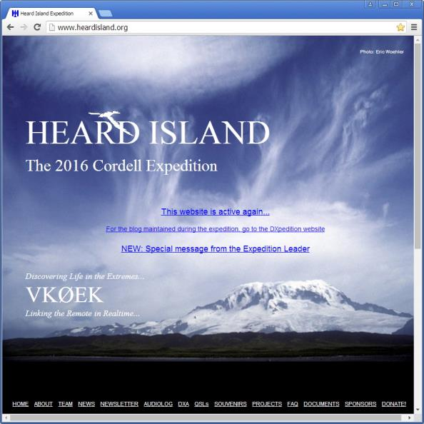
heardisland.org

Slide 6
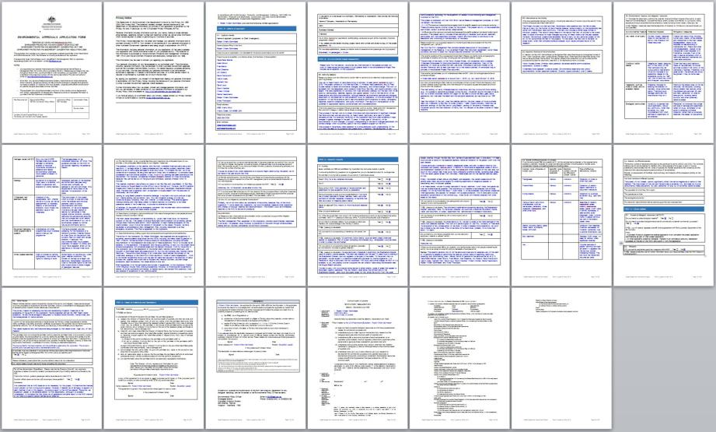
PERMIT APPLICATION

Slide 7
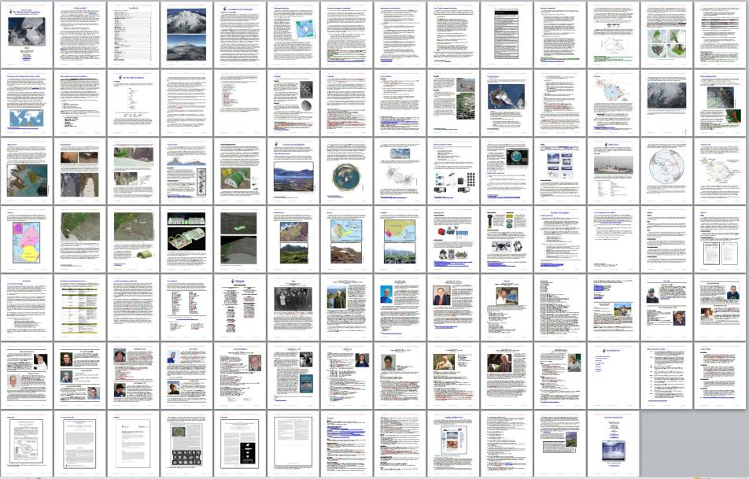
PROJECT DESCRIPTION

Slide 8
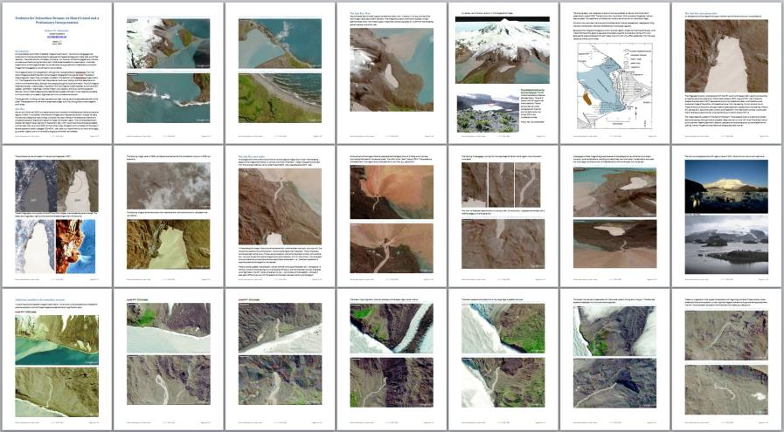
SCIENTIFIC PROPOSALS (7)

Slide 9
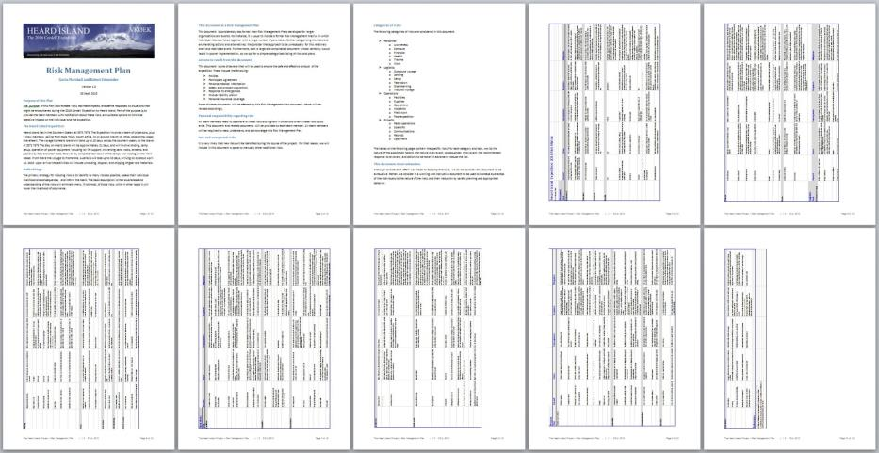
RISK MANAGEMENT PLAN

Slide 10
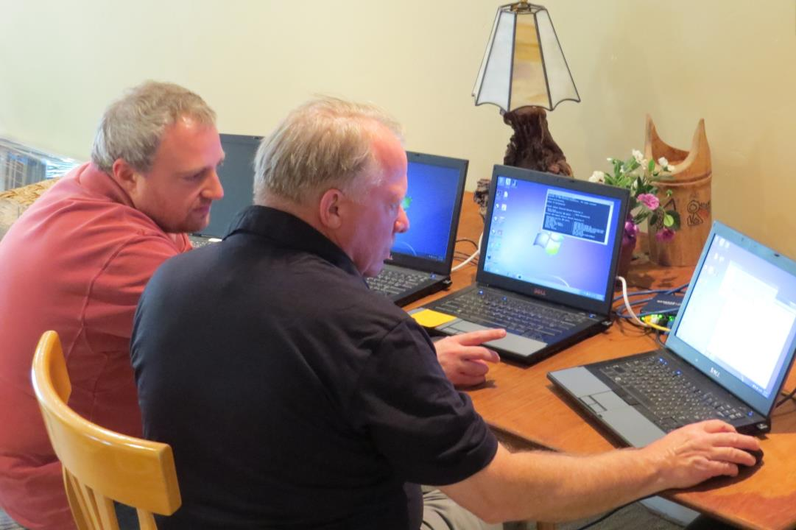

Slide 11
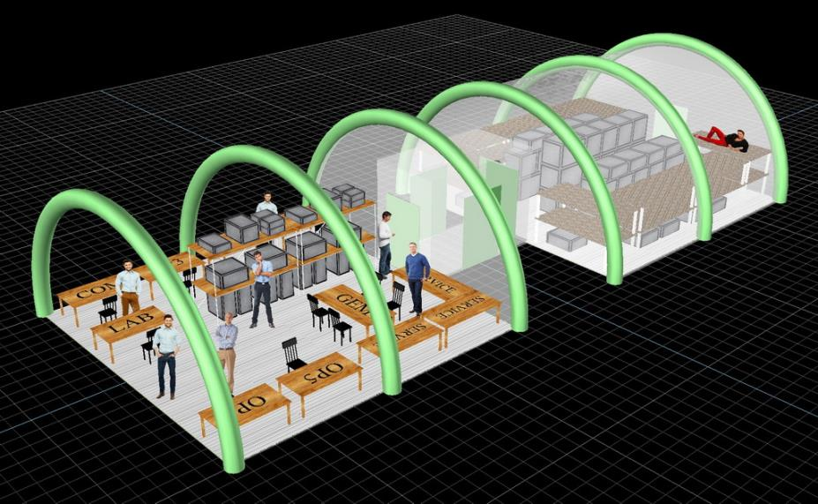
THE AIRBEAM SHELTER

Slide 12
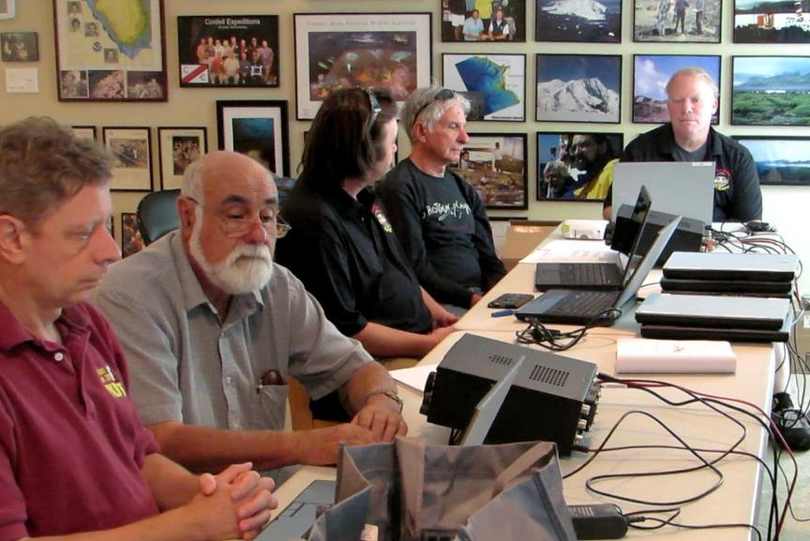

Slide 13
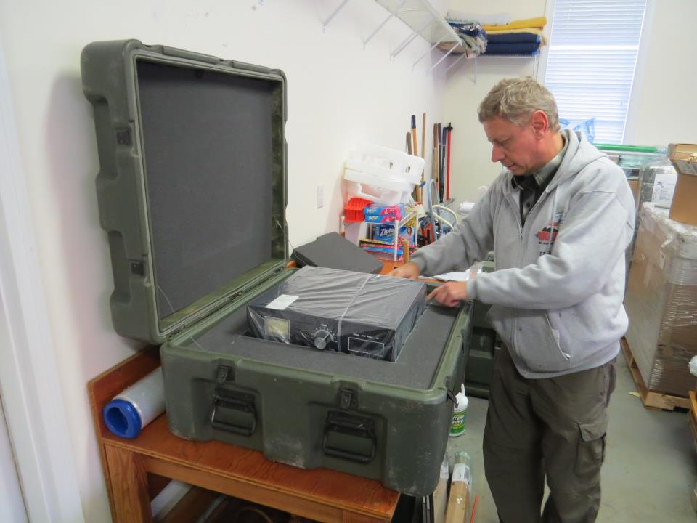

Slide 14
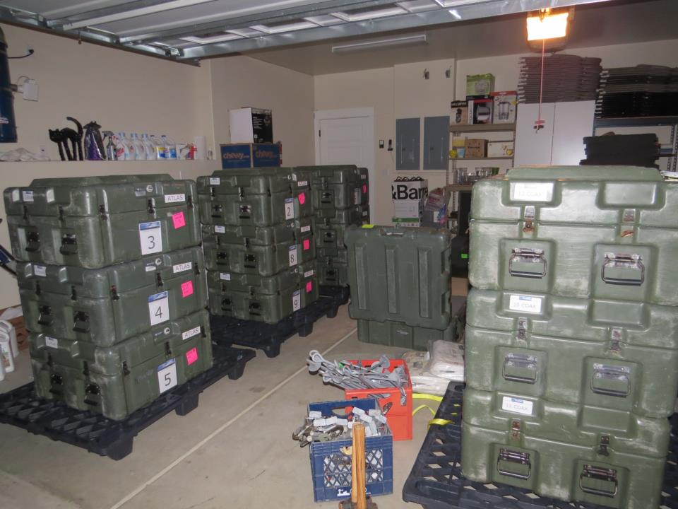

Slide 15
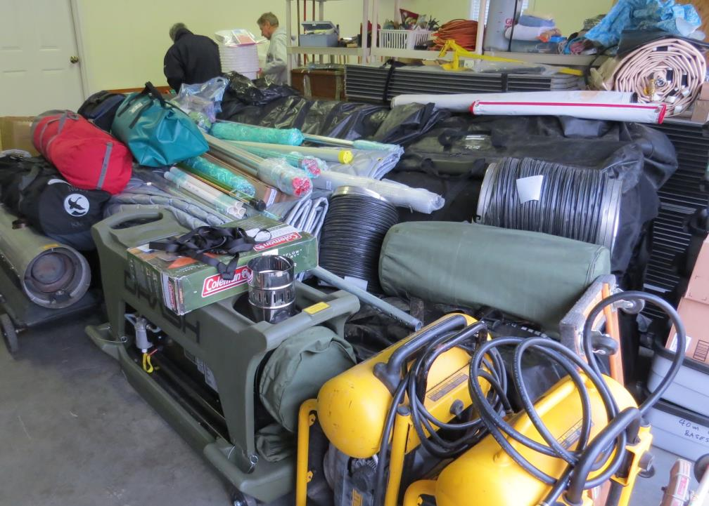

Slide 16
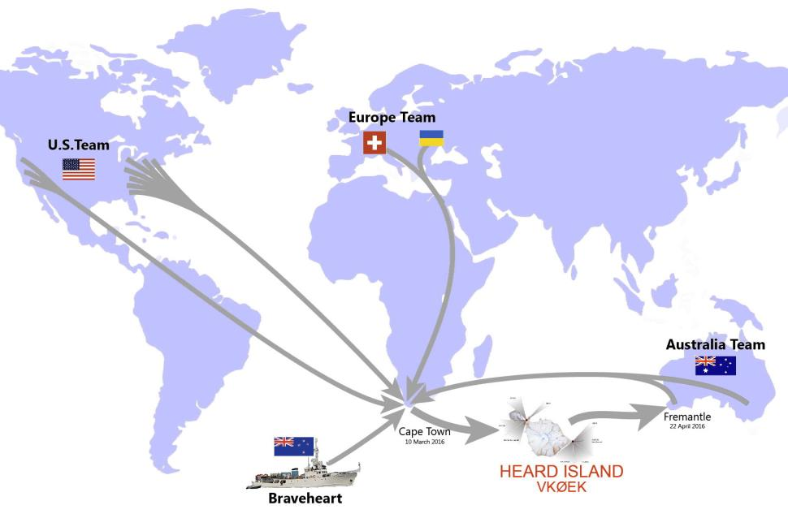

Slide 17
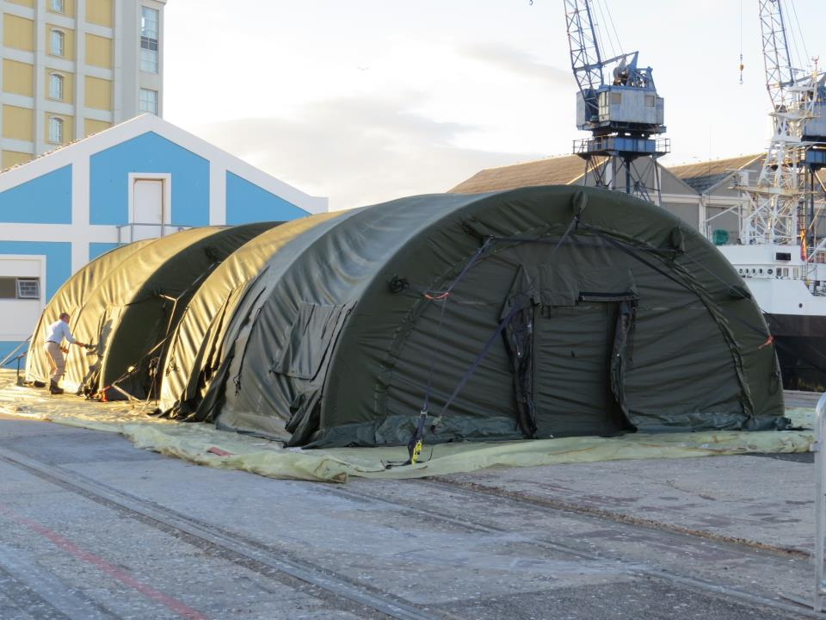

Slide 18
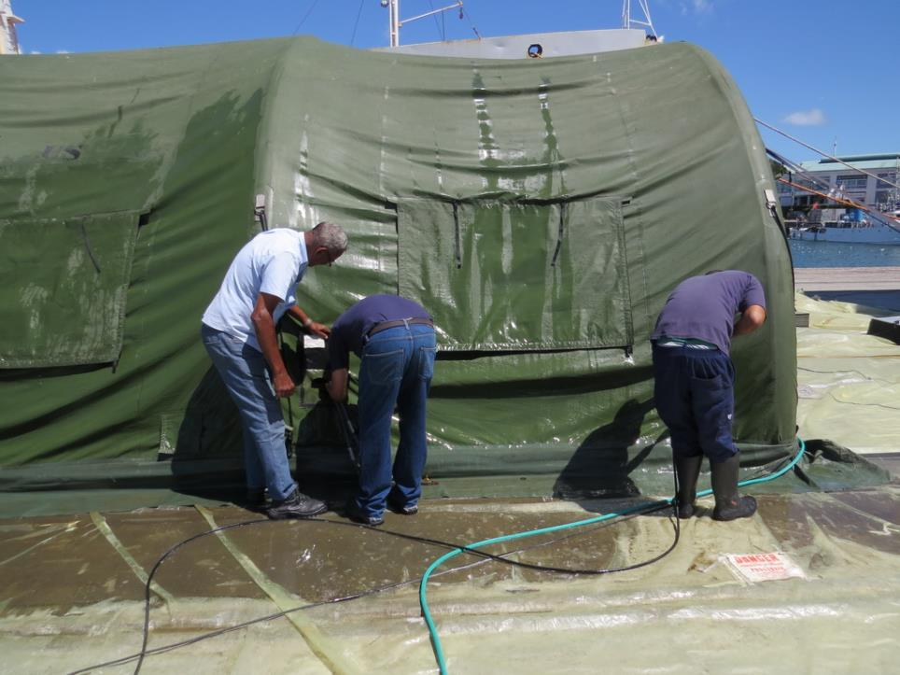

Slide 19
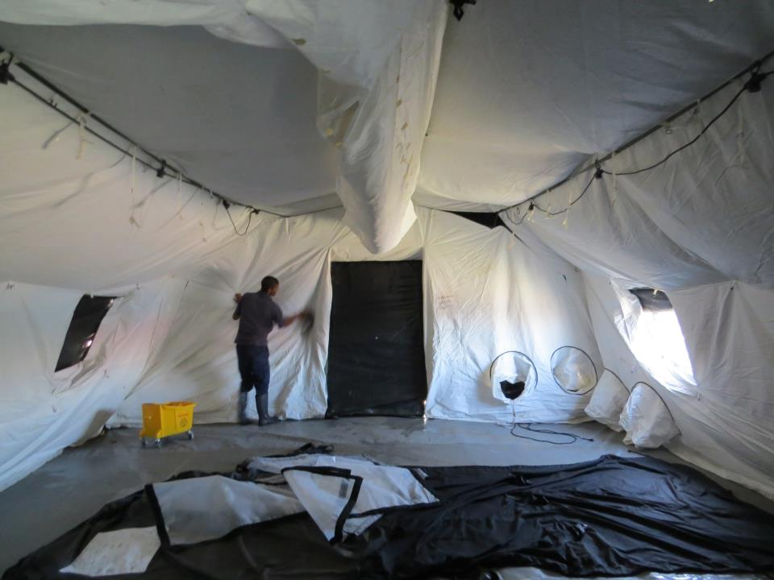

Slide 20
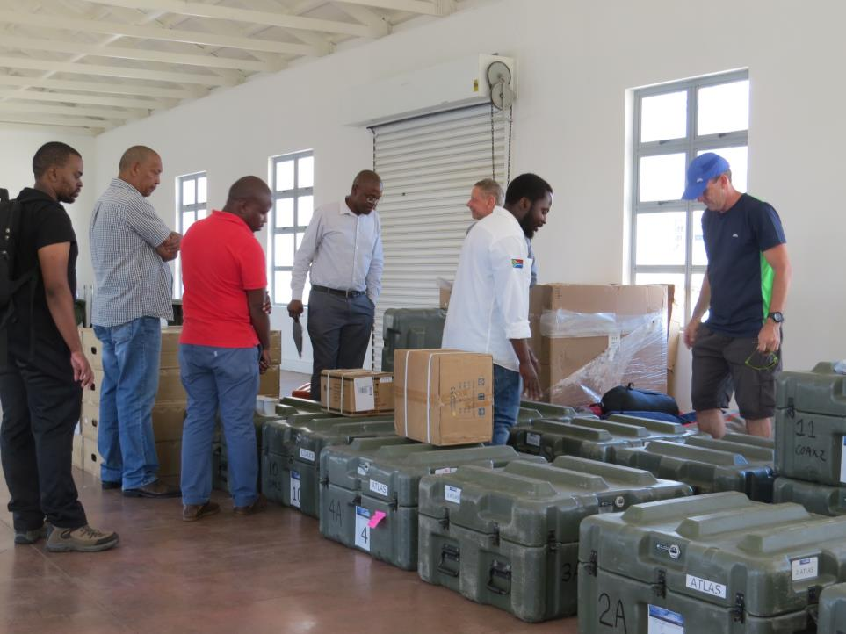

Slide 21
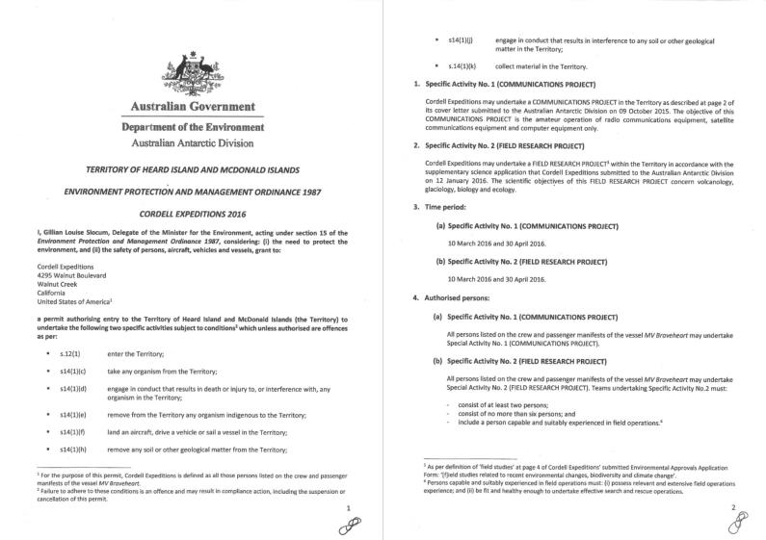
THE PERMIT
(+ 13 more pages)

Slide 23
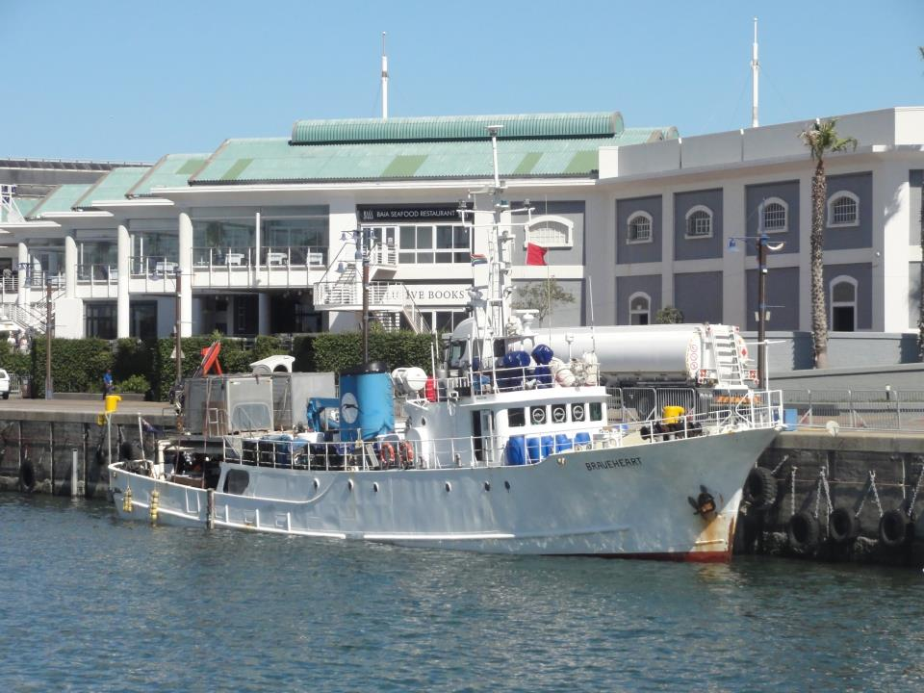

Slide 24
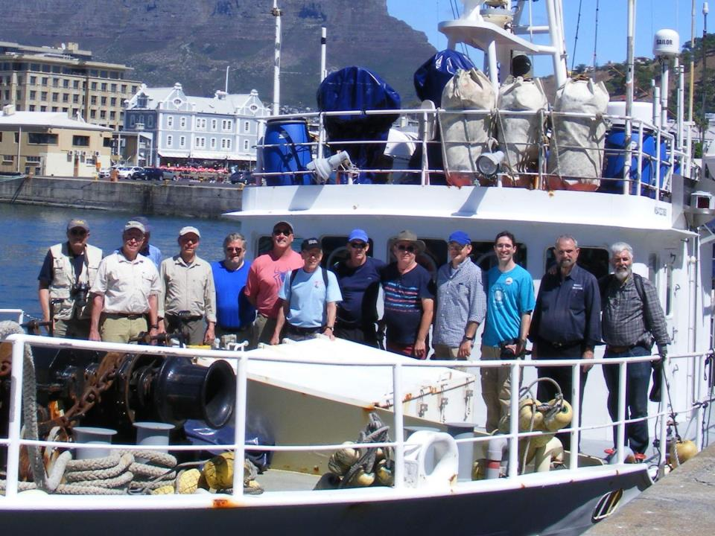

Slide 25
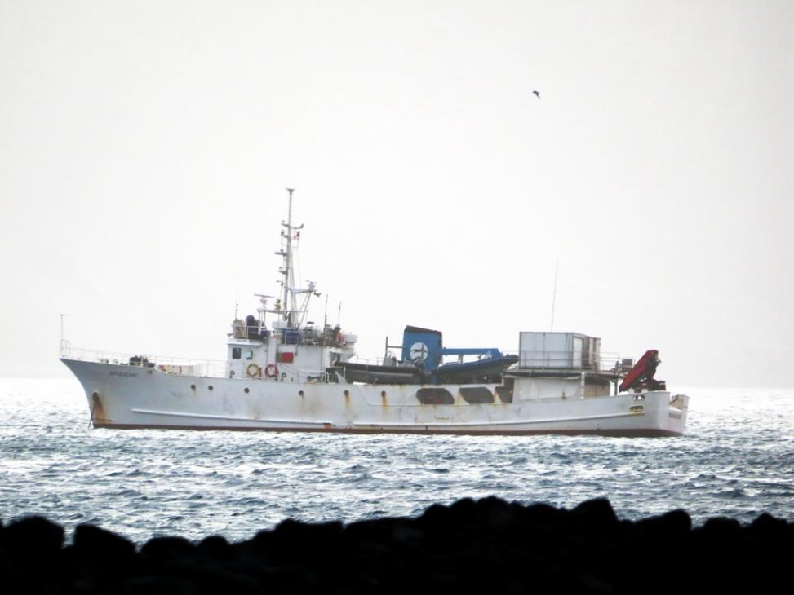

Slide 26
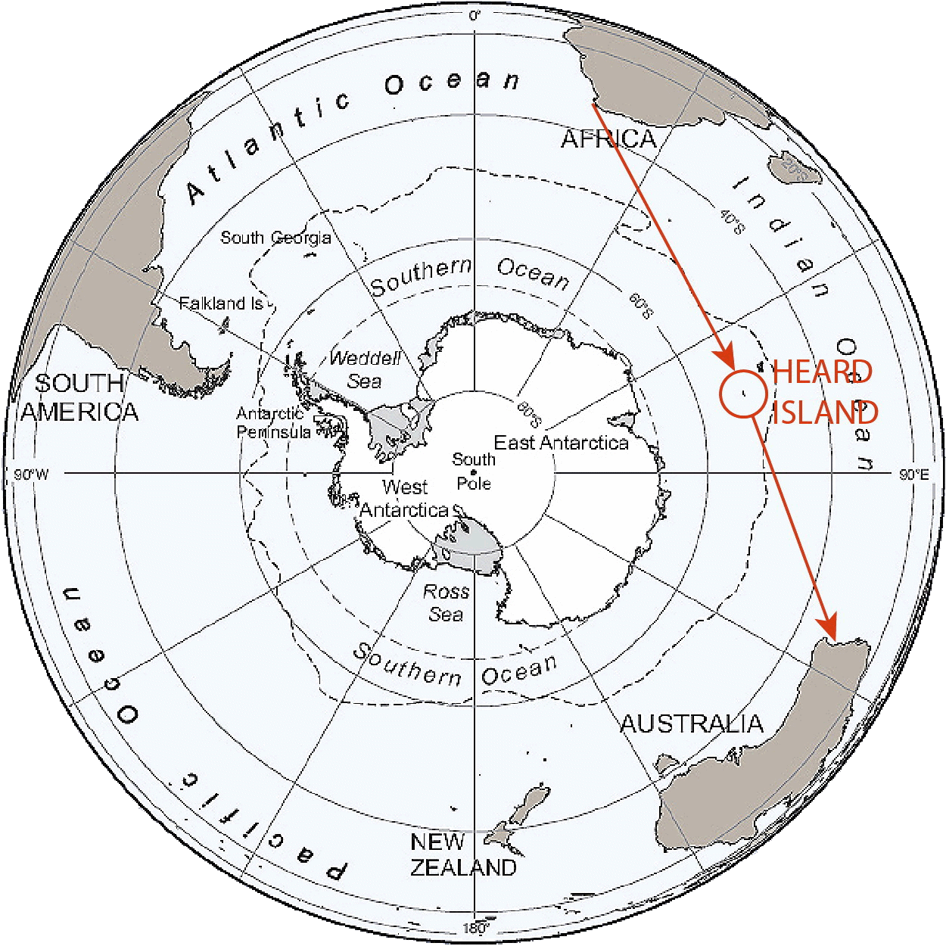

Slide 27
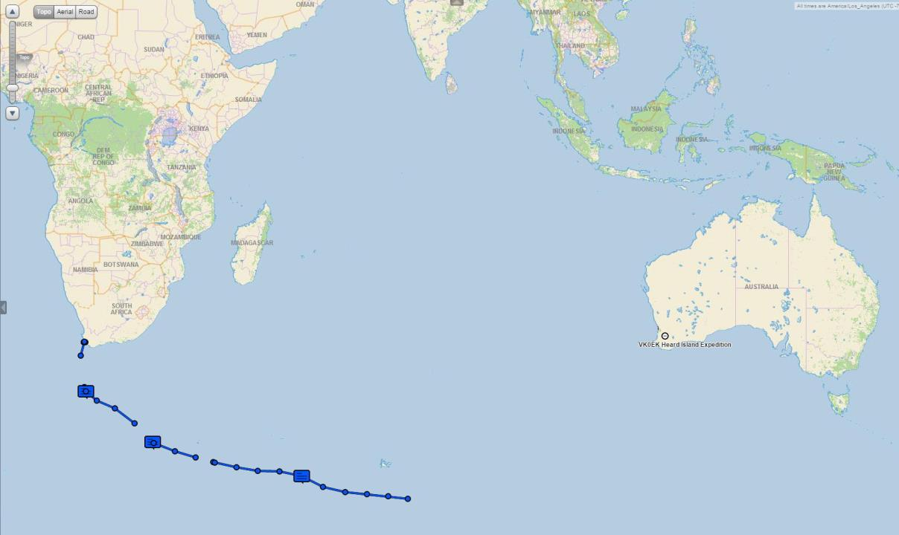

Slide 28
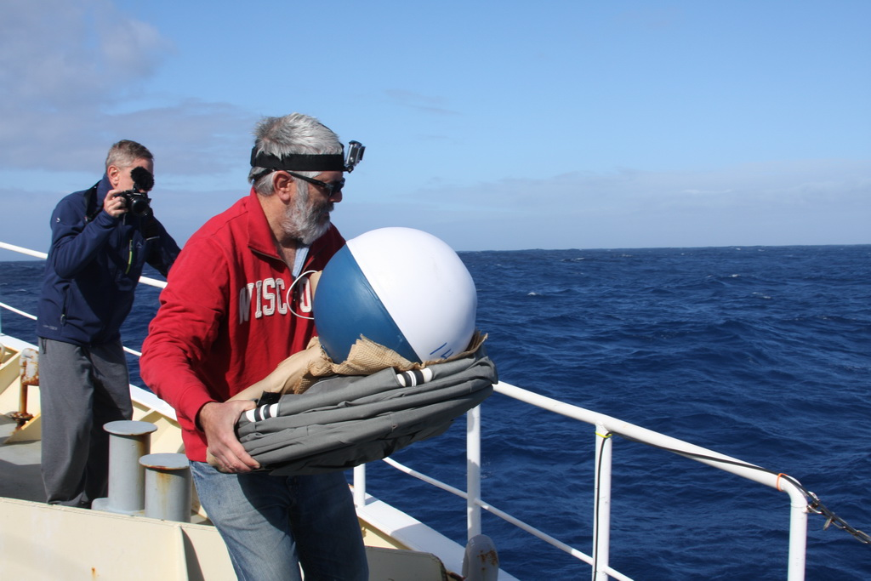

Slide 29
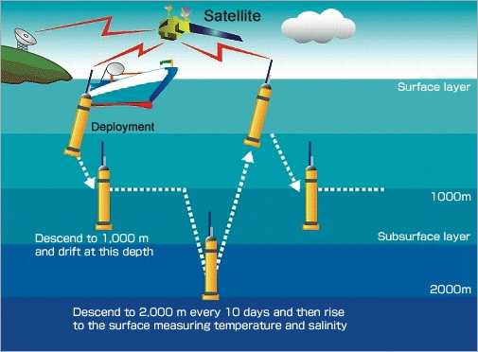

Slide 30
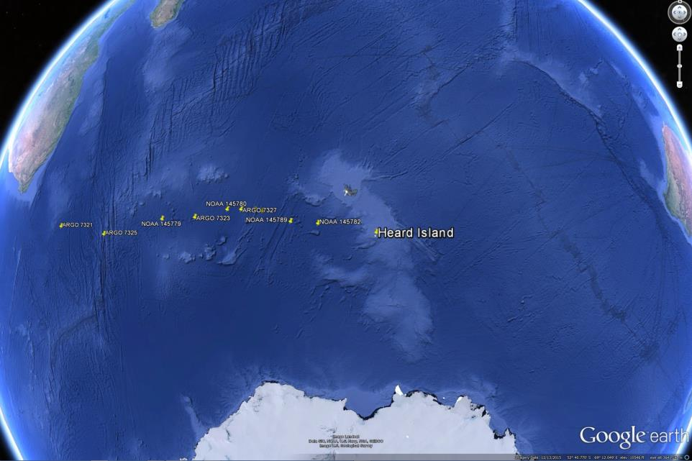

Slide 31
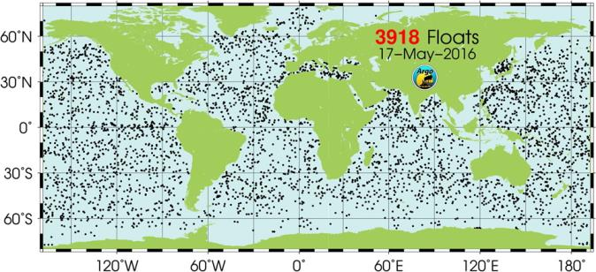
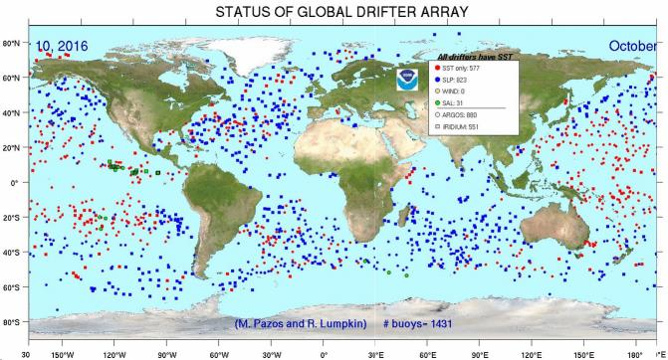
WHOI Divers
NOAA drifters

Slide 32
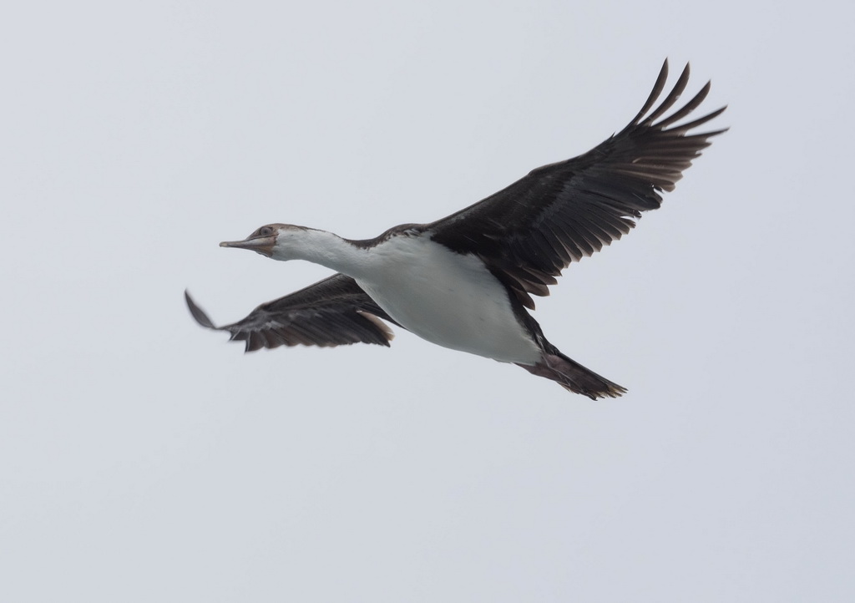
Fairy prion
Heard Island
cormorant

Slide 33
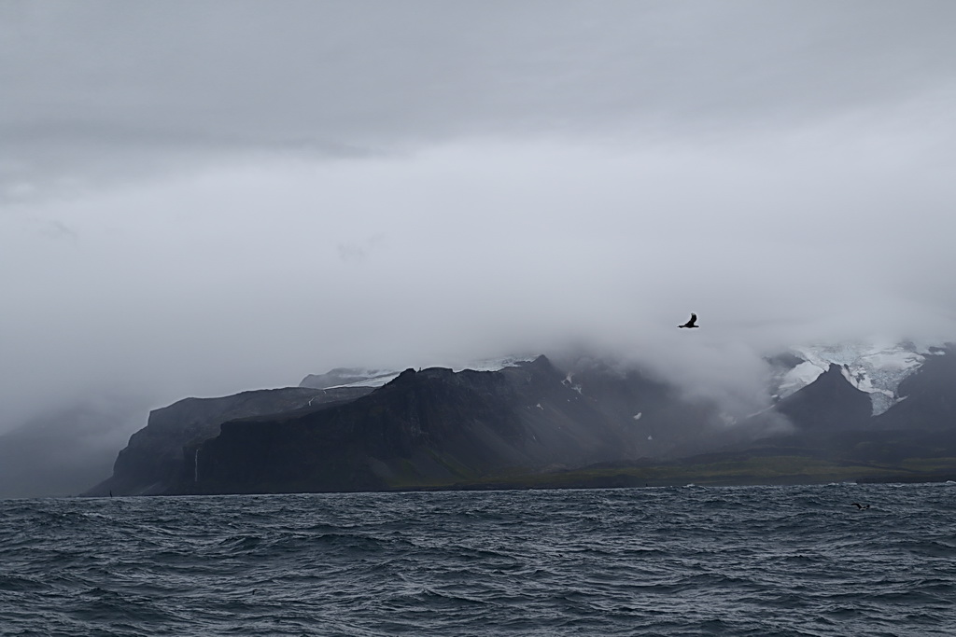

Slide 34
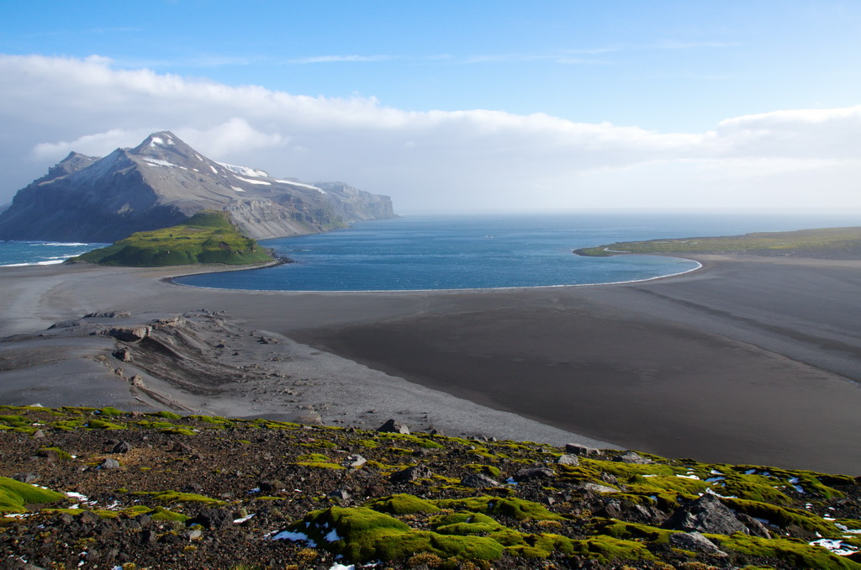
Atlas Cove

Slide 35
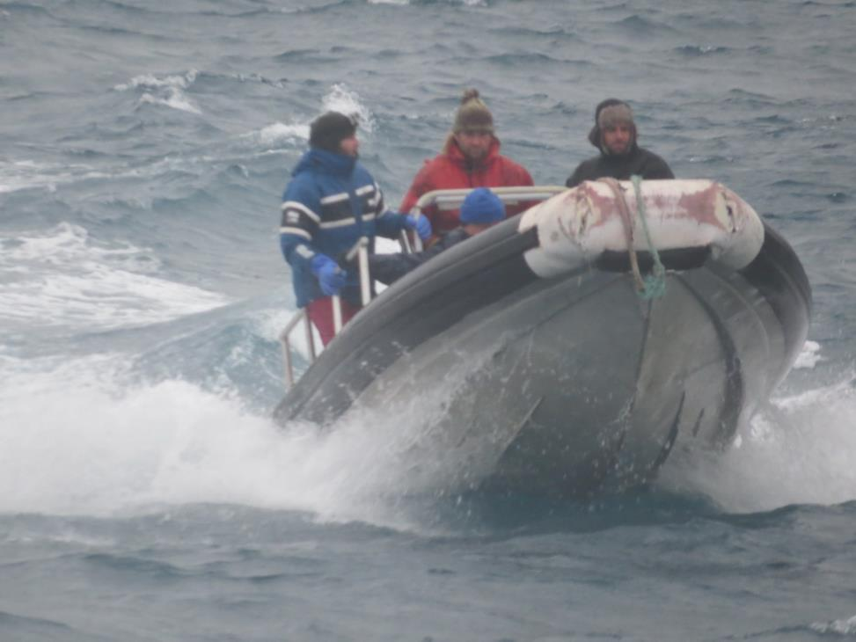

Slide 36
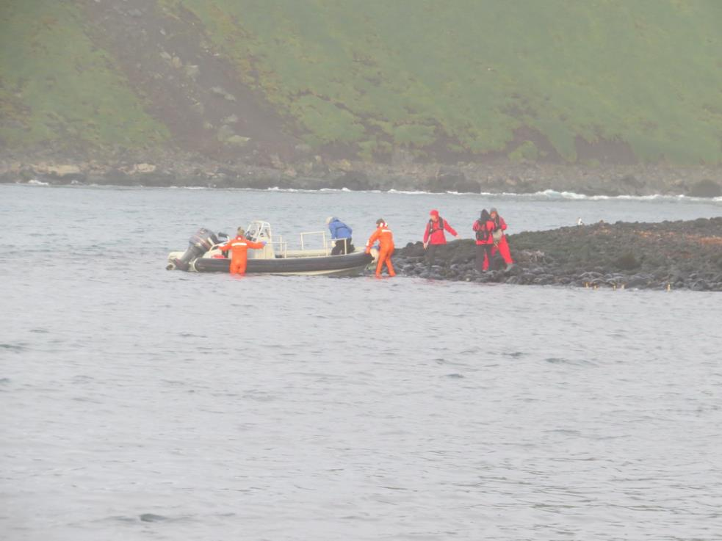

Slide 37
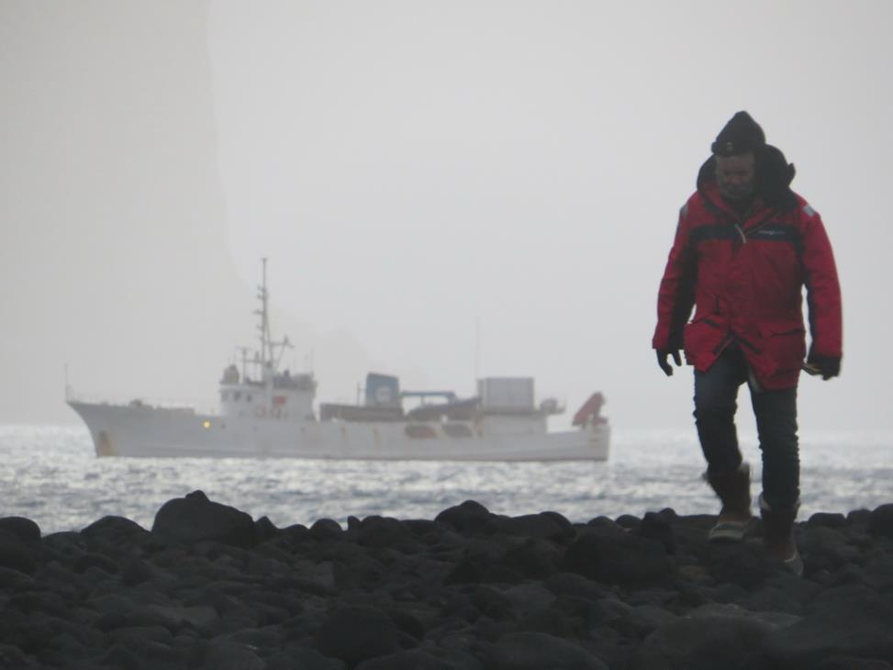

Slide 38
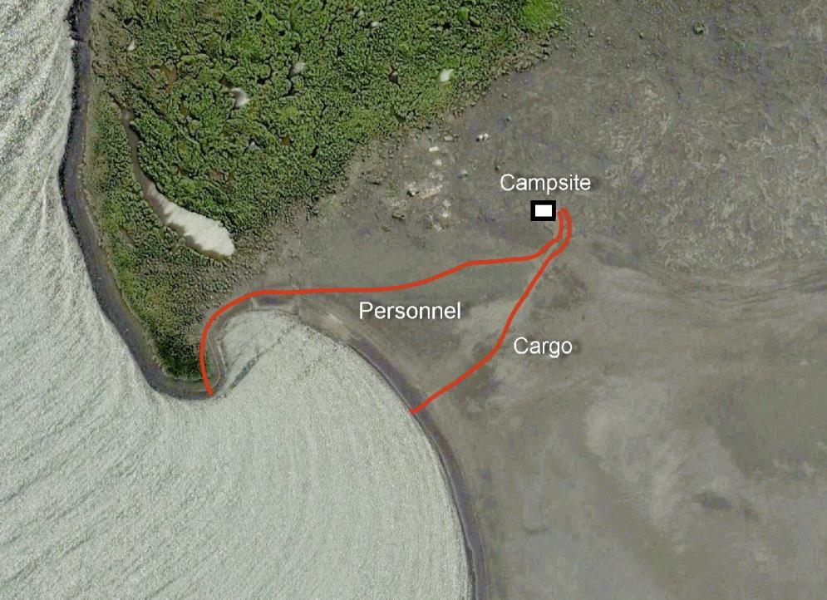

Slide 39
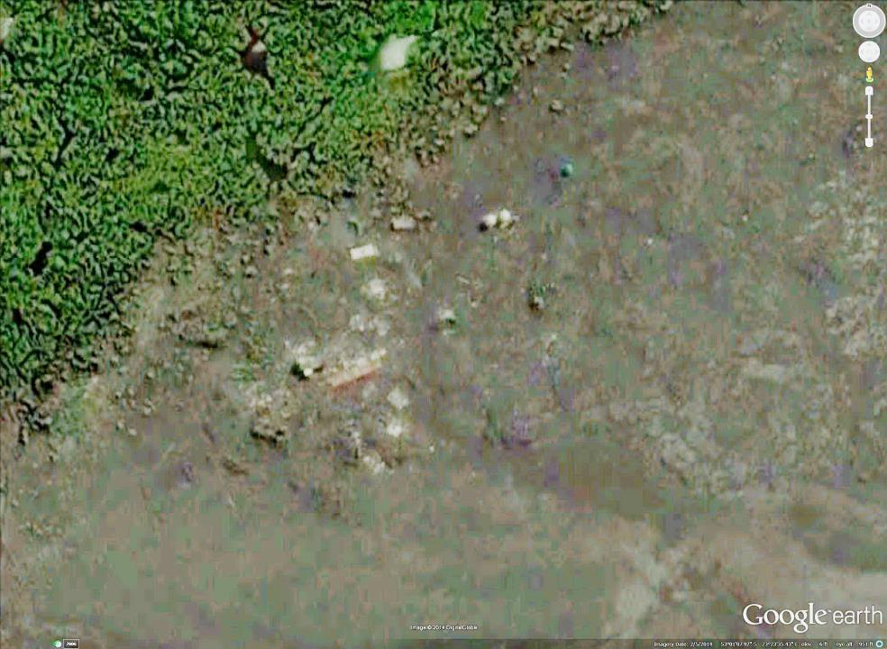
1997 VKØIR
2003 SHELTERS
1947 RESEARCH
STATION
2016 VKØEK
CAMPSITE

Slide 40
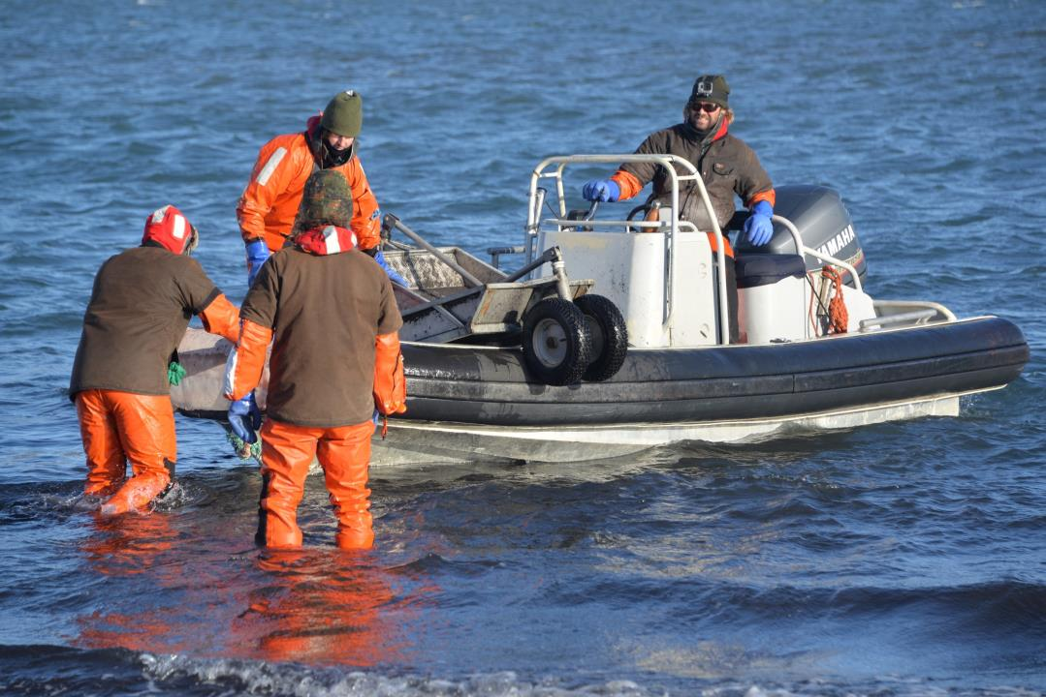

Slide 41
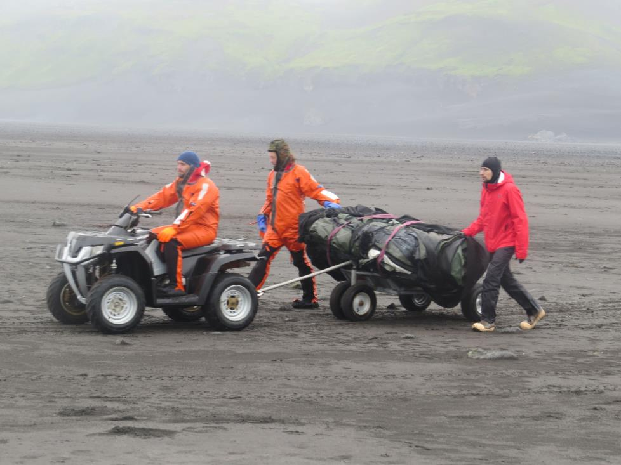

Slide 42
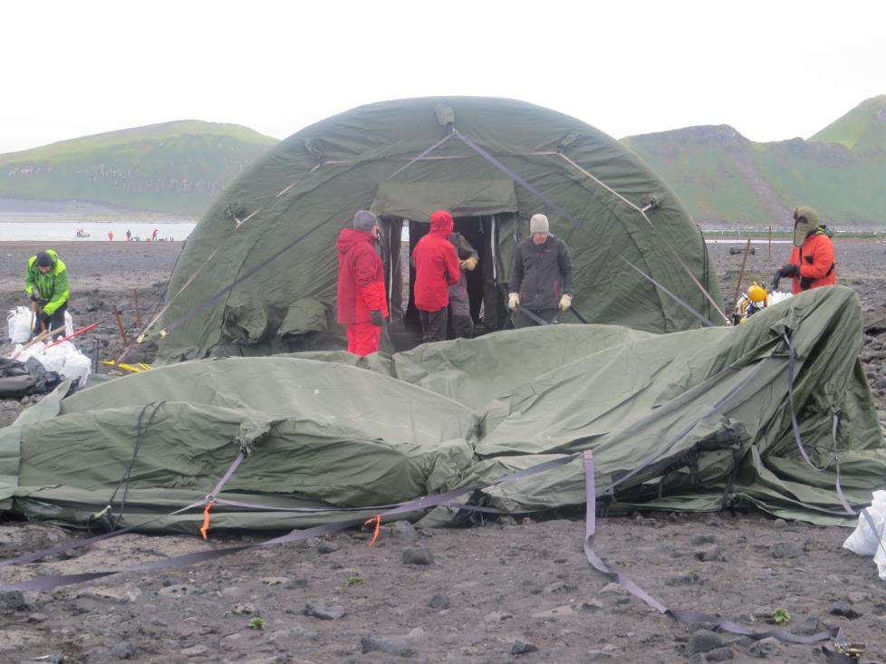

Slide 43
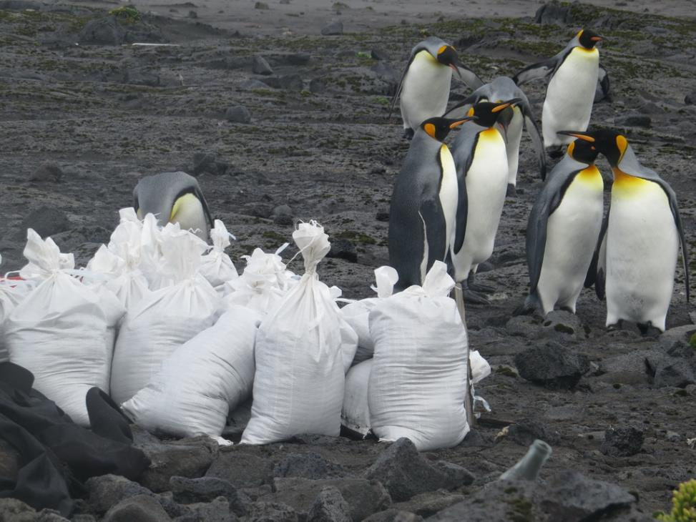

Slide 44
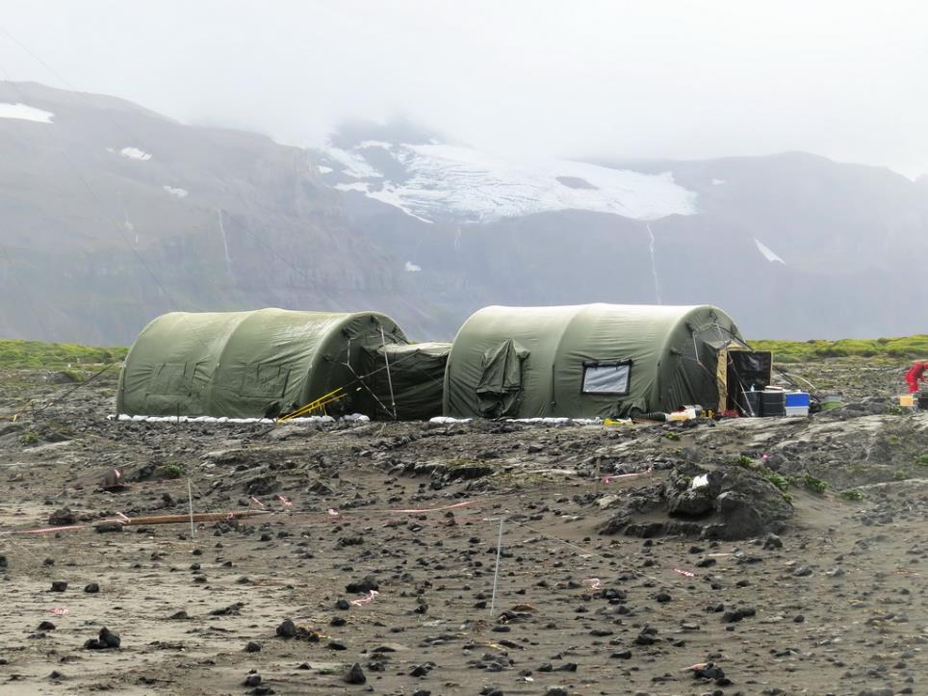

Slide 45
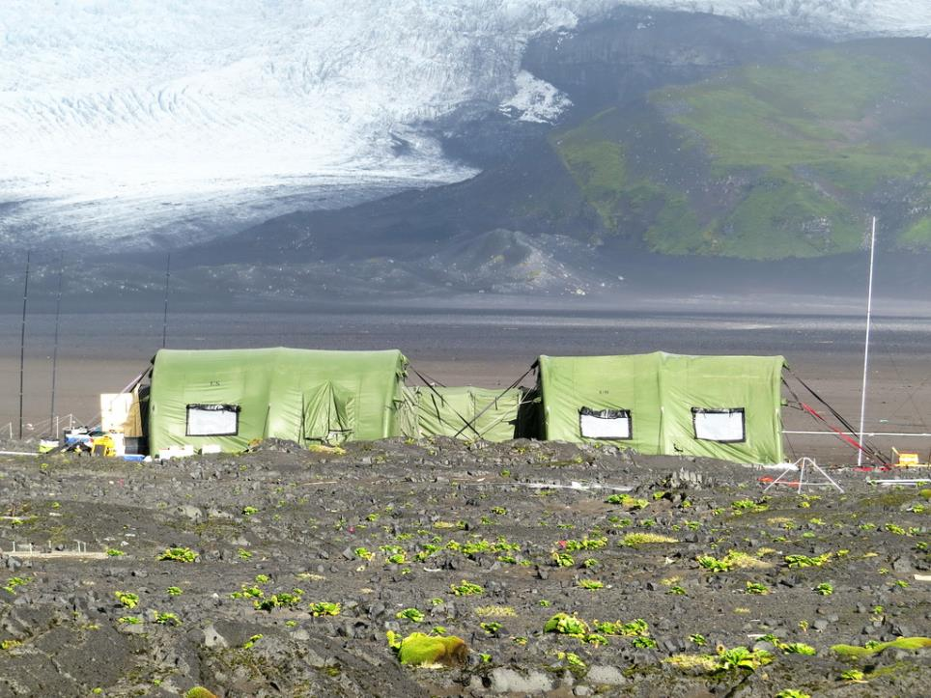
Mawson Peak
2 miles up
Operations
Dormatory

Slide 46
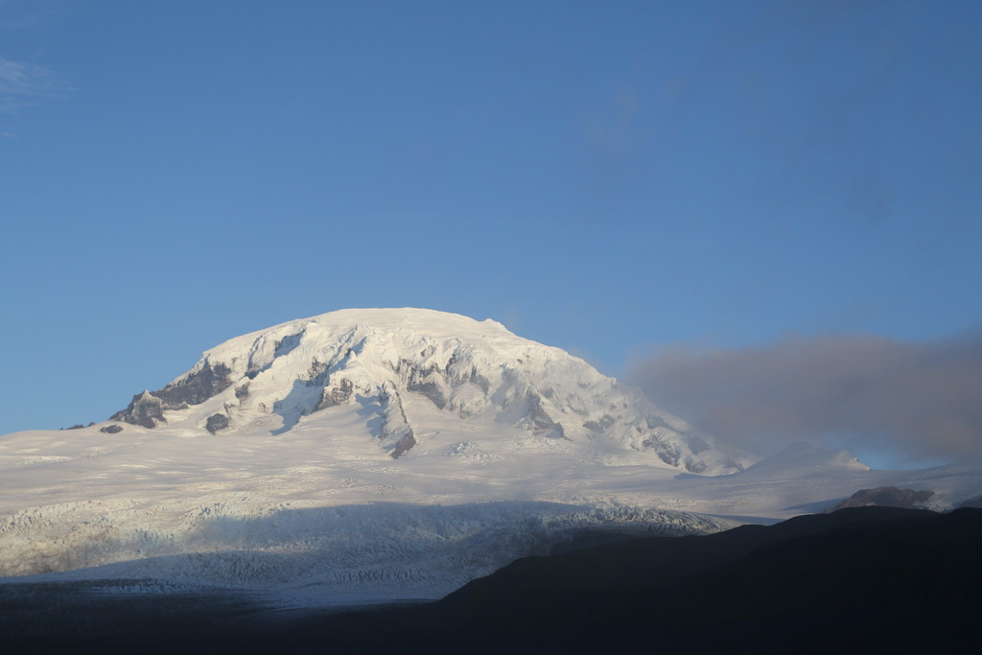

Slide 47
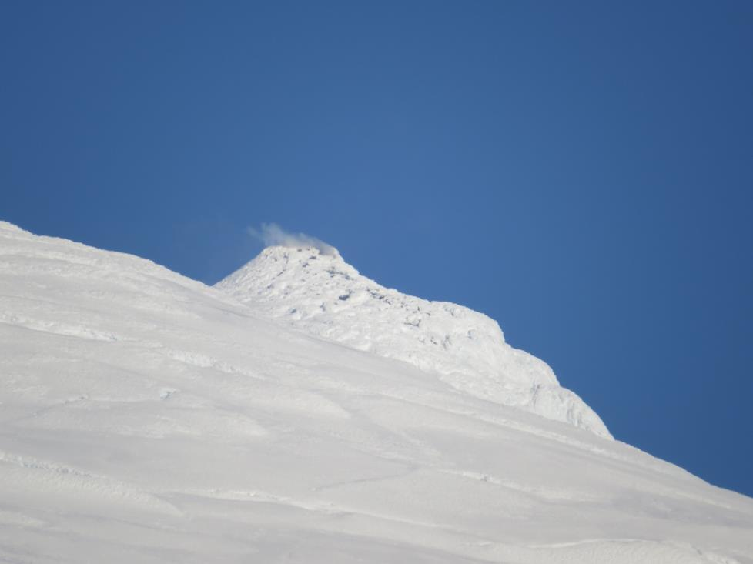

Slide 48
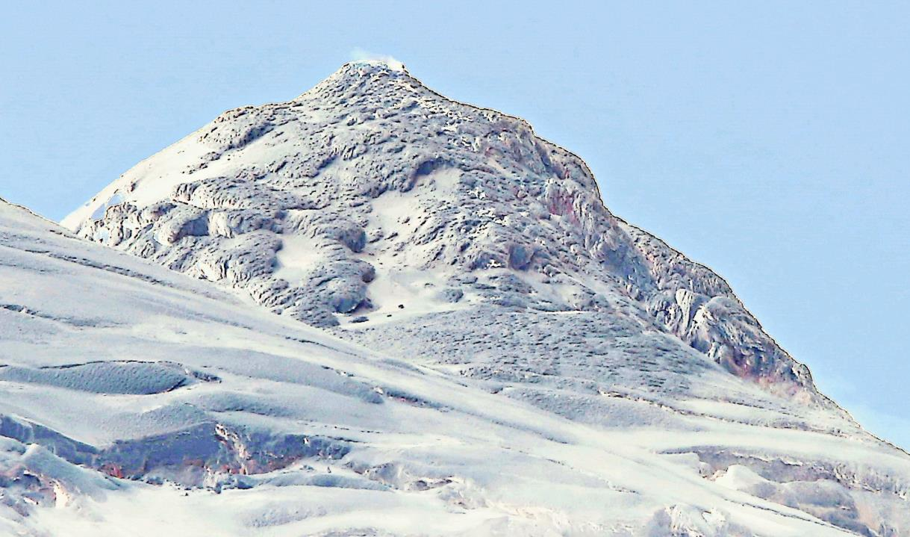

Slide 49
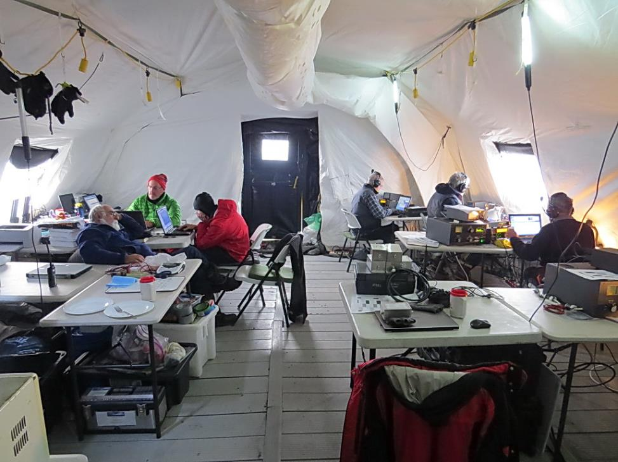

Slide 50
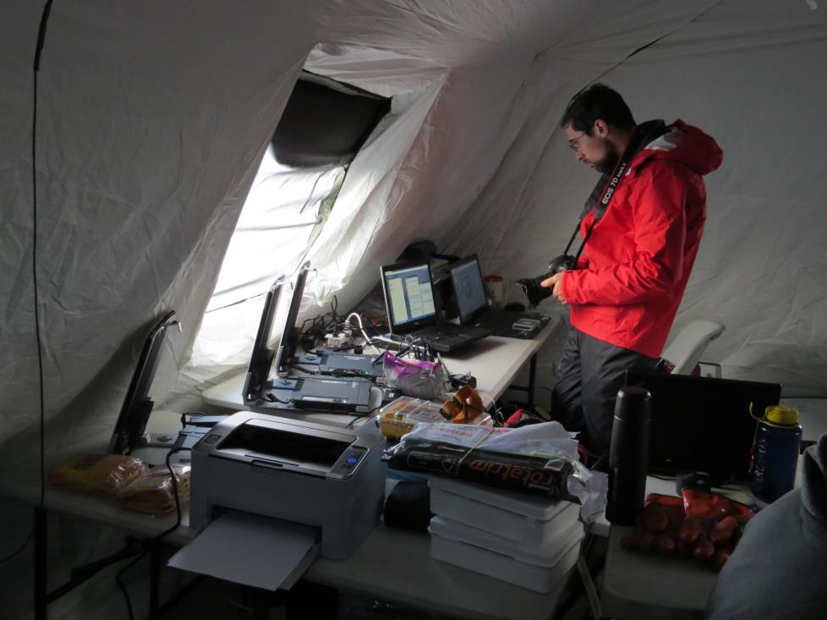

Slide 51
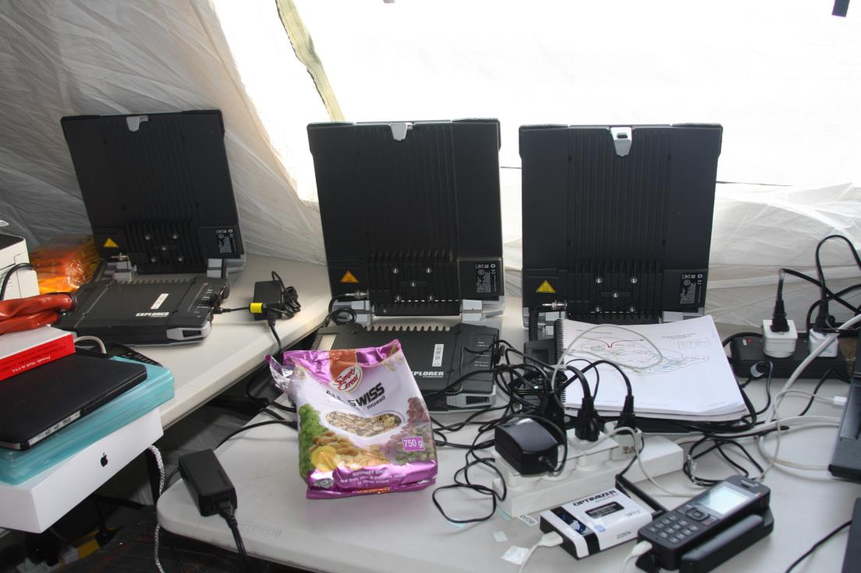

Slide 52
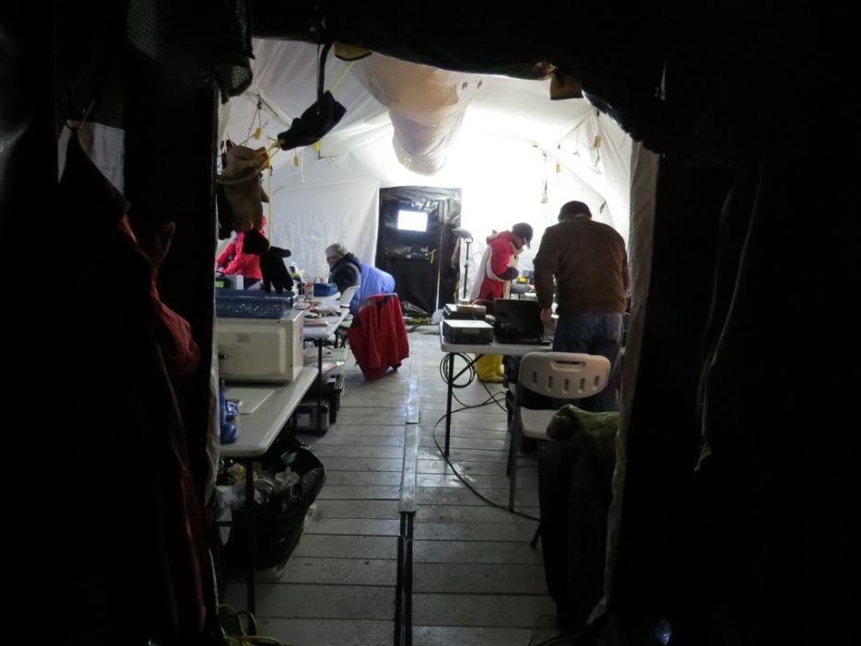

Slide 72
The end of penguins
Notice the feet!

Slide 87
Eruption

Slide 106
Ice slump

Slide 108
Blue gash

Slide 110
Finding the entrance to the lagoon

Slide 111
Entrance to the lagoon

Slide 113
The subsurface stream exit

Slide 115
Slump

Slide 116
The slump

Slide 120
Galcial ice, gin, and tonic

Slide 122
The VKØEK Team
NP4IW
VK6CQ
KK6EK
HB9AXE
K2ARB
KM4MXD
W7XU
WJ2O
K3EL
UT4UD
NG2H
VK2BAX
N6TQ
AEØEE

Slide 127
The Heard Island visitors log

Slide 130
The gear
comes
home

Slide 131
Studying the specimens

Slide 132
1 mm gravel

Slide 133
Olivine crystals

Slide 134
Unidentified fibrous plant

Slide 135
WINGLESS FLY
(Anatalanta aptera)
Heard Island
Reference

Slide 139
THE ONLINE AUDIO LOG

Slide 140
THE NEWSLETTERS

Slide 142
ARTICLES

Slide 143
The 14 men
AEØEE
KK6EK
K3EL
VK6CQ
KM4MXD
VK2BAX
UT6UD
N6TQ
NG2H
NP4IW
WJ2O
HB9AXE
W7XU
WJ2O
K2ARB

Slide 144
ORGANZATIONS

Slide 145
Last Newsletter will credit everyone!

Slide 146
Heard Island 2016
Robert W. Schmieder
Cordell Expeditions
Explorers Club
18 Nov. 2016

